Slide 1
Evaluation of Clustering
Lecture no 24

Slide 2
Cluster Validity
For supervised classification we have a variety of measures to evaluate how good our model is
Accuracy, precision, recall
For cluster analysis, the analogous question is how to evaluate the “goodness” of the resulting clusters?
Then why do we want to evaluate them?
To avoid finding patterns in noise
To compare clustering algorithms
To compare two sets of clusters
To compare two clusters

Slide 3
Clusters found in Random Data
Random Points
DBSCAN
K-means
Complete Link

Slide 4
Measures of Cluster Validity
Numerical measures that are applied to judge various aspects of cluster validity, are classified into the following three types.
External Index: Used to measure the extent to which cluster labels match externally supplied class labels.
Entropy
Internal Index: Used to measure the goodness of a clustering structure without respect to external information.
Sum of Squared Error (SSE)
Relative Index: Used to compare two different clusterings or clusters.
Often an external or internal index is used for this function, e.g., SSE or entropy

Slide 5
Measuring Cluster Validity Via Correlation
Two matrices
Proximity Matrix
“Incidence” Matrix
One row and one column for each data point
An entry is 1 if the associated pair of points belong to the same cluster
An entry is 0 if the associated pair of points belongs to different clusters
Compute the correlation between the two matrices
Since the matrices are symmetric, only the correlation between n(n-1) / 2 entries needs to be calculated.
High correlation indicates that points that belong to the same cluster are close to each other.

Slide 6
Measuring Cluster Validity Via Correlation
Correlation of incidence and proximity matrices for the K-means clusterings of the following two data sets.
Corr = -0.9235
Corr = -0.5810

Slide 7
Using Similarity Matrix for Cluster Validation
Order the similarity matrix with respect to cluster labels and inspect visually.

Slide 8
Using Similarity Matrix for Cluster Validation
Clusters in random data are not so crisp
DBSCAN

Slide 9
Using Similarity Matrix for Cluster Validation
Clusters in random data are not so crisp
K-means

Slide 10
Using Similarity Matrix for Cluster Validation
Clusters in random data are not so crisp
Complete Link

Slide 11
Using Similarity Matrix for Cluster Validation
DBSCAN

Slide 12
Internal Measures: SSE
Clusters in more complicated figures aren’t well separated
Internal Index: Used to measure the goodness of a clustering structure without respect to external information
SSE
SSE is good for comparing two clusterings or two clusters (average SSE).
Can also be used to estimate the number of clusters

Slide 13
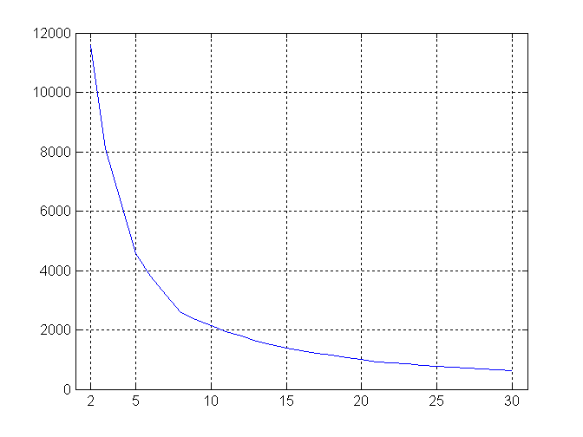
Internal Measures: SSE
SSE curve for a more complicated data set
SSE of clusters found using K-means

Slide 14
Internal Measures: Cohesion and Separation
Cluster Cohesion: Measures how closely related are objects in a cluster
Example: SSE
Cluster Separation: Measure how distinct or well-separated a cluster is from other clusters
Example: Squared Error
Cohesion is measured by the within cluster sum of squares (SSE)
Separation is measured by the between cluster sum of squares
Where |C_{i}| is the size of cluster i

Slide 15
Internal Measures: Cohesion and Separation
Example: SSE
BSS + WSS = constant
m
×
×
×
1
m₁
2
3
4
m₂
5
K=1 cluster:
K=2 clusters:

Slide 16
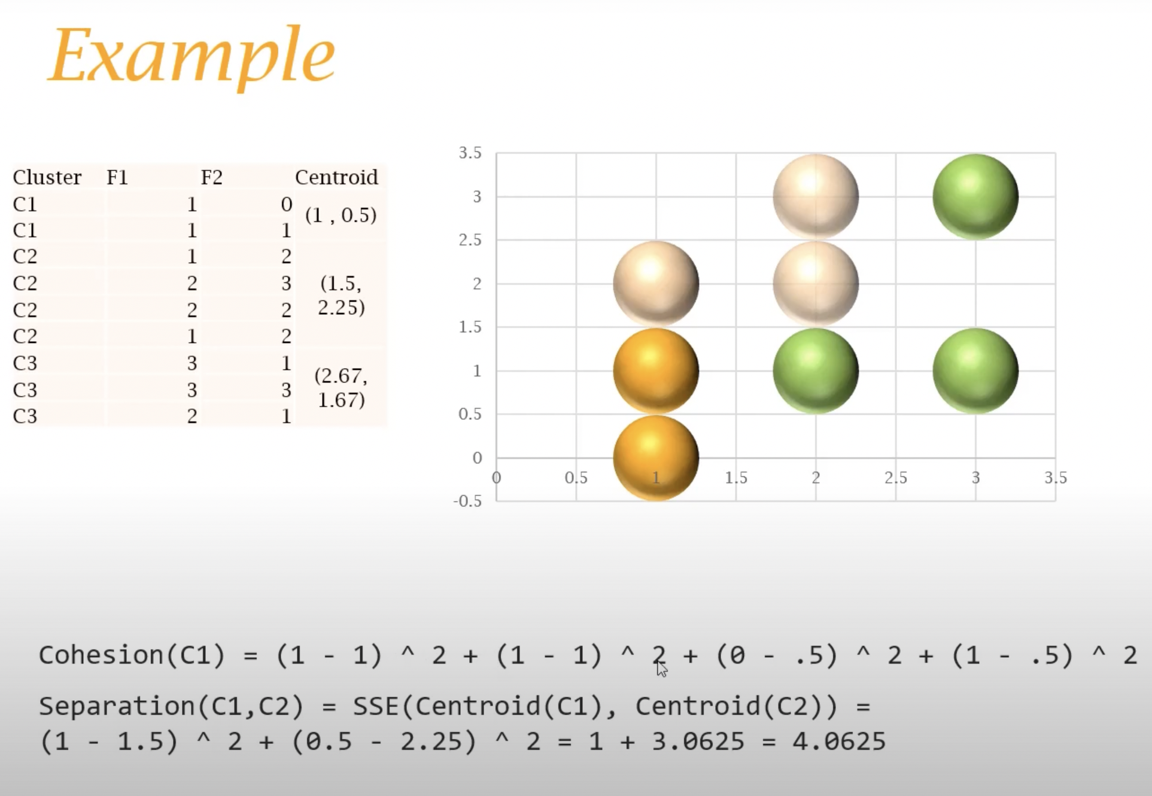
= 0.5

Slide 17
Internal Measures: Cohesion and Separation
A proximity graph based approach can also be used for cohesion and separation.
Cluster cohesion is the sum of the weight of all links within a cluster.
Cluster separation is the sum of the weights between nodes in the cluster and nodes outside the cluster.
cohesion
separation

Slide 18
Internal Measures: Silhouette Coefficient
Silhouette Coefficient combine ideas of both cohesion and separation, but for individual points, as well as clusters and clusterings
For an individual point, i
Calculate a = average distance of i to the points in its cluster
Calculate b = min (average distance of i to points in another cluster)
The silhouette coefficient for a point is then given by s = 1 – a/b if a < b, (or s = b/a - 1 if a ≥ b, not the usual case)
Typically between 0 and 1.
The closer to 1 the better.
Can calculate the Average Silhouette width for a cluster or a clustering

Slide 19
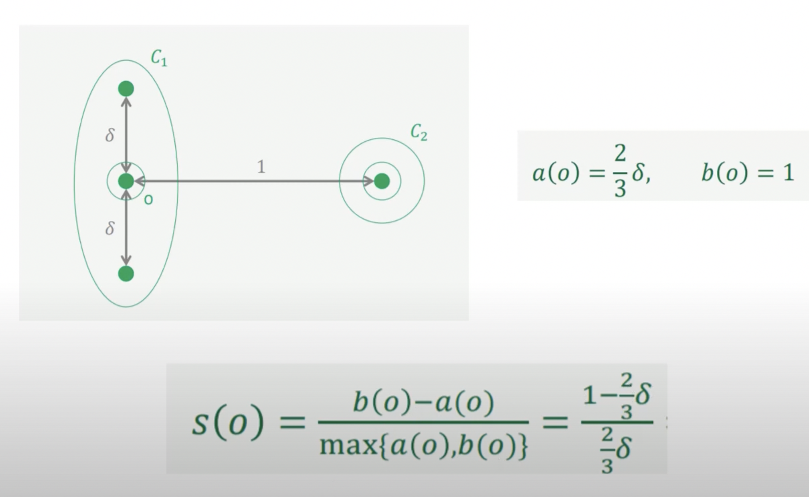
Example - Silhouette Coefficient

Slide 20
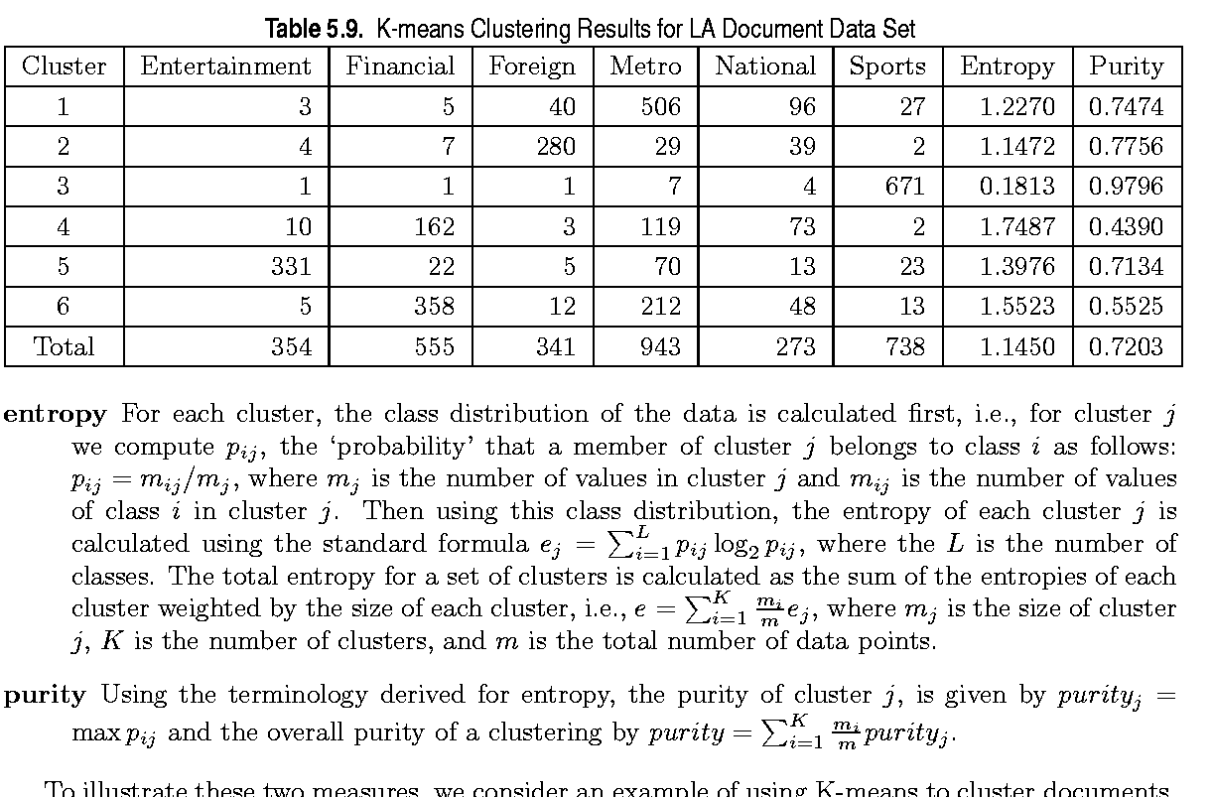
External Measures of Cluster Validity: Entropy and Purity

Slide 21
Homework / Activity
Do Research on Davies-Bouldin Index
https://www.geeksforgeeks.org/davies-bouldin-index/

